Slide 1
I see His blood upon the rose.

Slide 2
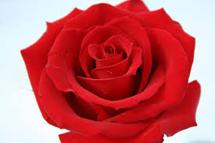

Slide 3
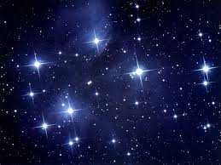
And in the stars the glory of His eyes,

Slide 4
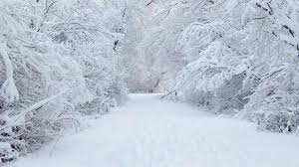
.....eternal snows

Slide 5
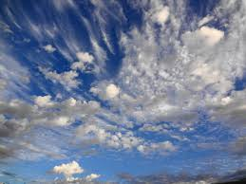
His tears fall from the skies...

Slide 6
I see His face in every flower..

Slide 8
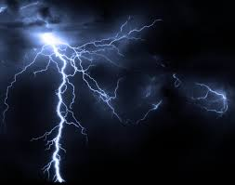
The thunder...

Slide 9
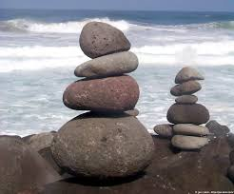
Rocks are His written words...

Slide 10
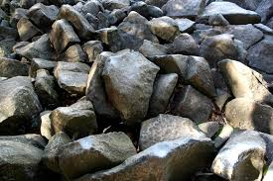

Slide 11
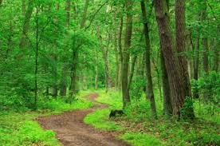
All pathways by His feet are worn,

Slide 12
..the ever beating sea...

Slide 13
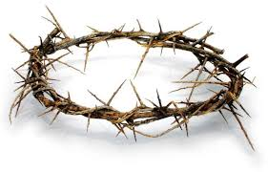
His crown of thorns...

Slide 14
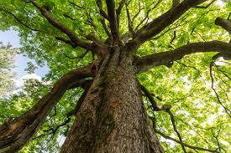
His cross is every tree.

